Slide 1
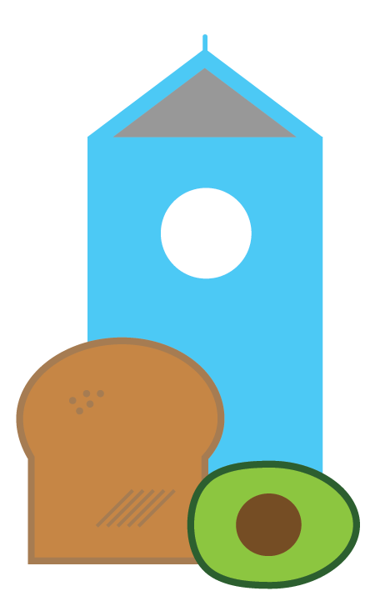


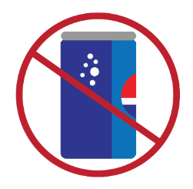


HEALTHY DOSE:
BOOSTING THE IMPACT OF COMMUNITY HEALTH STRATEGIES
Center for Community Health and Evaluation
www.cche.org

Slide 2
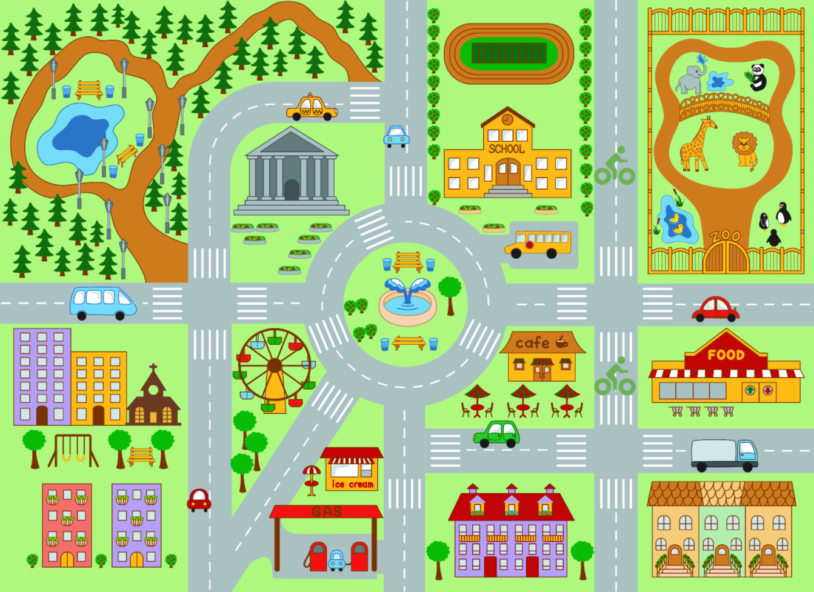




Dose in communities
Notes:
Health improvement initiatives, such as those focused on obesity, often seek to improve policies, programs, and neighborhood environments.
Population dose is a way to describe the relative impact of these community health promotion strategies and to estimate the combined impact of multiple cross-sector strategies that focus on the same health behavior.
Illustration credits
Map: Thinkstock
Icons: Carol Cahill

Slide 3
Overview of dose methodology
Group strategies into clusters by outcome
Assess lives touched – reach – and impact on those lives – strength – for each strategy
Calculate each strategy’s dose = reach x strength
Add dose of all strategies in a cluster to calculate population dose – impact of these strategies on a behavior
Notes:
In order to calculate potential or actual dose of a group of strategies in a community, there are 4 key steps.
First, all strategies need to be grouped into clusters by the behavior they seek to target. We typically use these 4 categories: Physical activity, healthy foods, fruit/vegetable consumption, and sugar sweetened beverage consumption.
Secondly, for each strategy in an outcome cluster, an assessment of the number of lives touched (reach) and impact on those lives (strength) is calculated, which we’ll talk about more in a minute.
Thirdly, dose for each strategies is calculated as the product of reach and strength.
Finally, the dose of all strategies in the cluster targeting 1 outcome can be added together to estimate the overall population dose – population level impact on the target behavior of this strategy cluster.

Slide 4
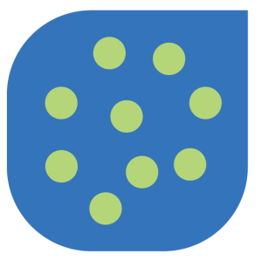

Measuring reach
The percentage of people in the community who are exposed to a strategy
REACH
Number of people exposed
Target population size
Notes:
Reach is measured by the percent of the people in your community who are exposed to the strategy. Reach equals the number of people reached divided by the size of the target community population.
Note the importance of clearly defining the target community in order to understand who we are trying to reach and how successful we are at impacting the community.

Slide 5

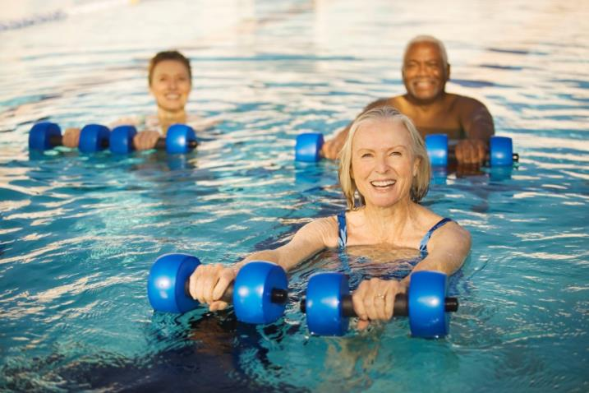

Measuring strength
Day-to-day lifestyle changes that increase activity or improve diet from a baseline level
The percentage improvement in lifestyle behaviors (more minutes of physical activity, more fruit & vegetable servings)
Notes:
Strength is where we estimate the percent change in a behavior such as the % increase in physical activity or % decrease in unhealthy food consumption.
The purpose is to quantify the impact these strategies are having on reached people.
Photo credits: Thinkstock

Slide 6
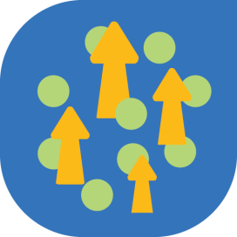


Calculating dose
DOSE
REACH
STRENGTH
Percent of people touched
Impact for each person touched
Notes:
We finally calculate dose as reach times strength, the percent of people touched times the impact on each of those people we were able to reach. We often use the term “population” dose because it applies to the whole community.
Dose methods give us a way to add and compare different kinds of community strategies (compare apples to oranges) using a common yardstick
to estimate impacts. For example, using dose we can compare a strategy like building more sidewalks to increase walkability (a high reach, but low intensity strategy) to a strategy like a walking group that meets every day (low reach, but high intensity).
Dose methodology adds up the impact of different strategies that target the same outcome and group of people.

Slide 7

Low reach, high strength
Notes:
The next three slides show some examples of applying dose to real-life strategies.
Exercise programs are typically low reach (compared to the whole community population) but often have a large impact on participants, so depending on the baseline levels of physical activity in the population served (i.e., if this is a high need population) then the overall dose can still be significant.
Photo credit: Thinkstock

Slide 8
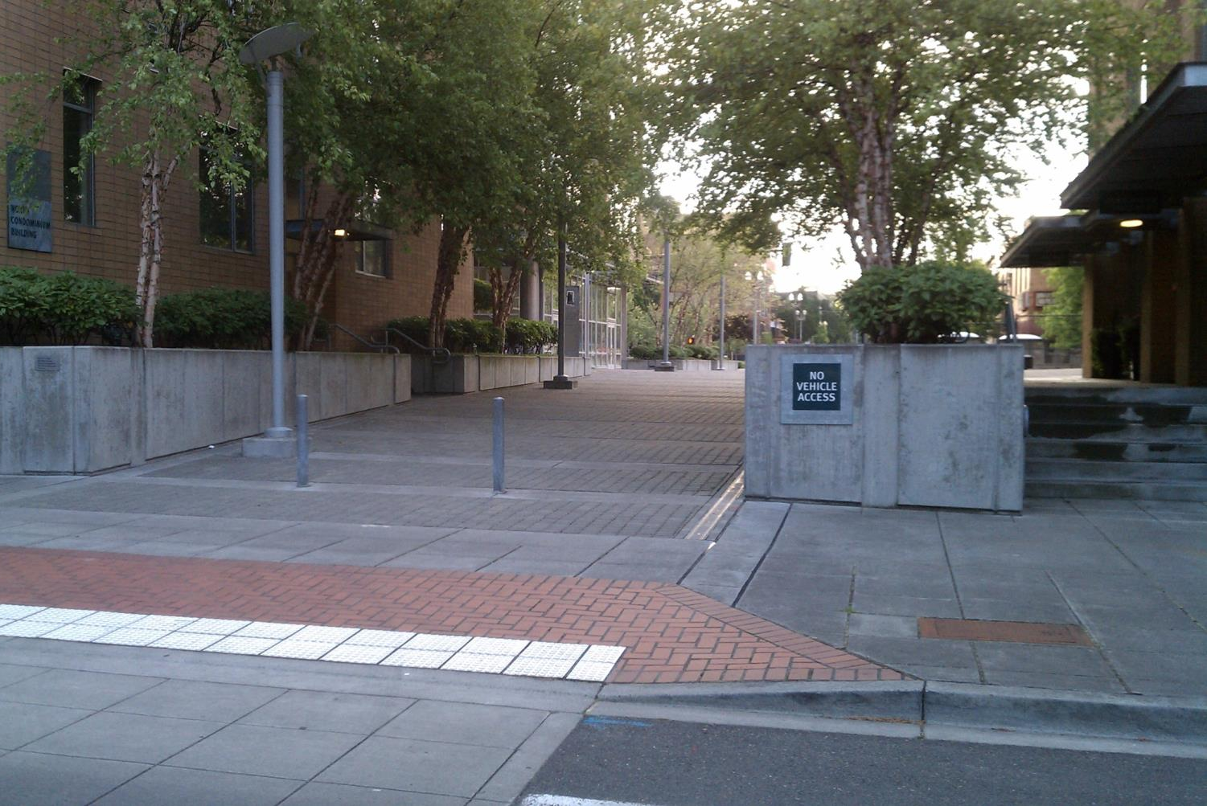
High reach, low strength
Notes:
Complete streets interventions are typically unlikely to have a big impact on each person reached (most people will not change their transportation patterns or amount of walking as a result) so they are low strength, but they do have high reach.
This is an example where context is important – sidewalk improvements may or may not stimulate changes in walking patterns depending on accessibility, what the sidewalk connects to, etc.
Photo credit: Carol Cahill

Slide 9
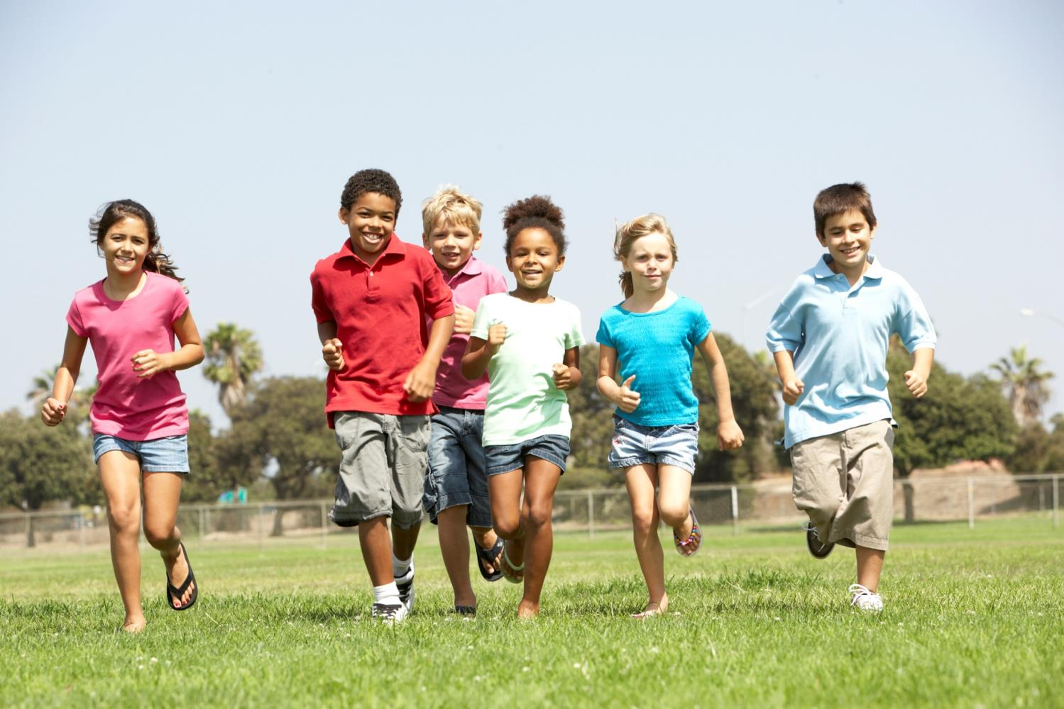
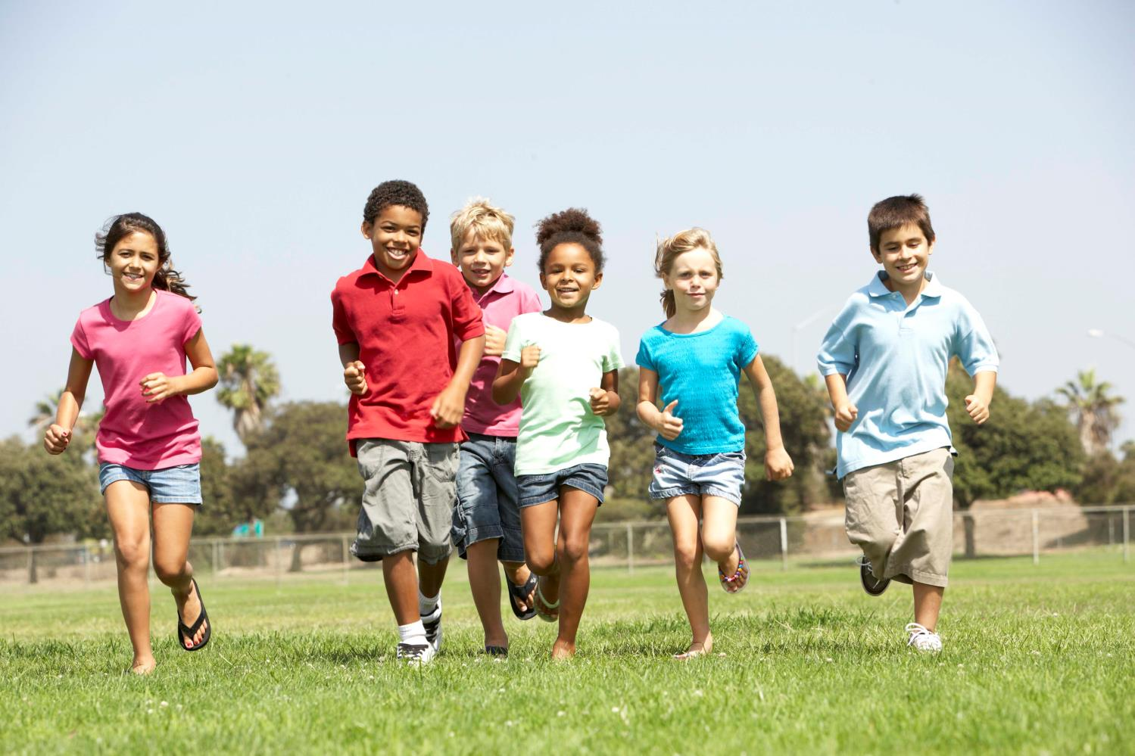
High reach, high strength
Notes:
School-based physical activity programs are often potentially high reach and high strength, which is very important because that means they are high dose – likely to have a significant population level impact. A PE curriculum change might add several minutes to daily physical activity for all students. Youth are often a captive audience which makes impacting their behavior much easier than the general community.
Photo credit: Thinkstock

Slide 10



Estimating population-level impact
Calculating dose for a cluster of youth physical activity strategies
Strategy | Reach | Strength | Dose
After school Zumba program | 5% low | 10% high | 0.5% minimal
Encourage active transport to school | 100% high | 2% low | 2% low
PE Curriculum changes | 100% high | 5% medium | 5% medium
Total youth physical activity dose |  |  | 7.5% High*
Population level physical activity is changing in youth, and is high enough to be measurable in a population survey
Notes:
If we calculate reach, strength, and dose for these three strategies, each individual strategy might have varying impact on youth physical activity.
However, added together, their combined impact is estimated to be high.
Calculations such as 7.5 aren’t meant to be taken literally, but rather to be indicators of whether small, medium, or large shifts in behavior might be occurring as a result of a strategy or combinations of strategies.
In this example, the population dose is high. Therefore we expect to see behavior change occurring that is significant enough to measure if we conducted a population level survey at this school.

Slide 11

Ways to increase population dose
Increase reach of existing strategies
Increase strength of existing strategies
Remove existing strategies
Add strategies, across sectors
Notes:
Increasing dose by increasing reach
Increasing reach requires spreading changes to more people—more neighborhoods, more facilities, or in the
example above, more students or more schools. Perhaps a Zumba program currently reaching 50 students or a
nutrition education program in one school could be expanded to include more students.
Increasing dose by increasing strength
Increasing strength means increasing the frequency, duration, and nature of the strategy. Perhaps students can be
encouraged to use the playground more through promotion and structured recess activities, or perhaps a school
cafeteria could offer 1-2 extra servings of fruits and vegetables instead of just ½ serving. Or maybe the school
cafeteria can promote themselves more and attempt increase participation in its programs.
Increasing dose by removing some strategies
This might seem counterintuitive, but once communities begin to implement strategies, some may fail to gain
momentum or encounter significant roadblocks. It is important to revisit the strategic plan periodically to determine
if dropping one or more strategies might be beneficial to free up resources that might be better spent elsewhere.
Perhaps the after school Zumba classes with 1% dose or the cooking matters classes with 0.1% dose are eating up
resources to pay for instructors with fairly low attendance, and instead that money could go towards an instructor to
provide structured recess or someone to provide nutrition education classes to a larger group of students instead.
Increasing dose by adding another strategy
Oftentimes, adding another strategy targeting the same outcome is useful, either because it can affect an as yet
unreached segment of the target population, or it can build momentum. Perhaps a school might be interested in
revamping the PE curriculum or simply adding minutes of PE into the day to increase overall activity of all students.
Perhaps a school district would add a salad bar to their cafeteria offerings.

Slide 12

Center for Community Health and Evaluation
www.cche.org
Notes:
Whether your focus is healthy eating, active lifestyles, or reducing neighborhood violence, chances are you’re trying to improve health for as many people as possible. Strategies can be designed and implemented in ways to increase their reach and strength—their dose—and thereby the likelihood of seeing health improvements at a population level.
Dose can be used for planning, for tracking implementation, and for evaluating final impact of an initiative. Dose matters because it holds the promise of helping us reach our goals faster, more efficiently, and with more lasting results than we would without the insights dose offers about what does and does not work to improve healthy behaviors.
Photo credit: U.S. Department of Agriculture

